Slide 1
International association of national public health institutes
2018 Annual Meeting| London, England
Global Burden of Disease Study
Professor John Newton, Director of Health Improvement - Public Health England

Slide 2
International association of national public health institutes
2018 Annual Meeting| London, England
Public Health England and Global Burden of Disease of
GBD 2010 Lancet paper on UK (published 2013)
GBD 2013 Lancet paper on England, regions and deprivation areas (published 2015)
Launch of WHO European Network for Burden of Disease studies (2016)
Health Profile for England using GBD (published 2017 and 2018)
Just published in 2018 GBD 2016 for UK countries, and with 150 local estimates
EC funded workshops in 2019 on use of Burden of Disease
or John Newton, Director of Health Improvement - Public Health England

Slide 3
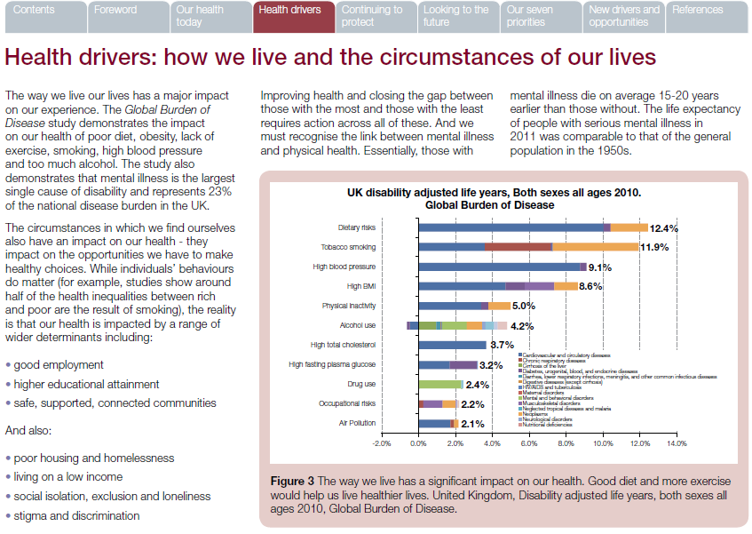
International association of national public health institutes
2018 Annual Meeting| London, England

Slide 4
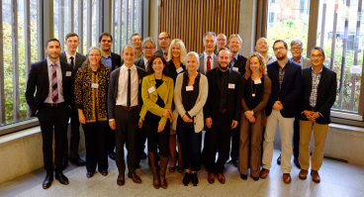
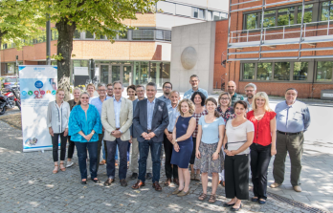
International association of national public health institutes
2018 Annual Meeting| London, England
The WHO European Burden of Disease Network
Set up as part of the European Health Information initiative
17 European countries
Supported by WHO Euro and IHME
London - September 2016
Oslo - August 2017
Berlin - August 2018
Stockholm – August 2019

Slide 5
International association of national public health institutes
2018 Annual Meeting| London, England
The European Burden of Disease Network (EBoDN)
To:
build capacity and promote good practice in countries,
establish sustainable national structures and resources,
harmonise Burden of Disease methodologies across Europe,
improve availability, quality and accessibility of national health information for Burden of Disease analysis,
improve reporting and communication of findings, incl. better understanding of health inequalities, social determinants and access to care

