Slide 1
Mozambique’s National Health Observatory: Integrating, Interpreting and Communicating Complex Mortality Data
Ilesh Jani, Director-General, Instituto Nacional de Saúde, Mozambique

Slide 2
Contents
Background
Mozambique’s National Health Observatory
Mortality Data Integration, including CHAMPS and COMSA
Concluding Remarks

Slide 3
Background
In Mozambique, health information faces several challenges:
Fragmentation
Low quality
Lack of adequate data on importante issues such as health indicators, health determinants, inequalities, etc
Project based with donor-defined and short-term aims
Difficult access
Low rates of usage
Etc.

Slide 4
The National Health Observatory (ONS) as a Policy Oriented Evidence Provider in Mozambique
Surveys
O.N.S.
Compilation
Integration
Analysis
Interpretation
Official Source
Policy Oriented
Annual Report
Subject Reports
Website/Dashboards
Workshops/Symposia
Research
Etc
Multisectoral Steering Committee
Secretariat at NPHI
INPUT
OUTPUT

Slide 5
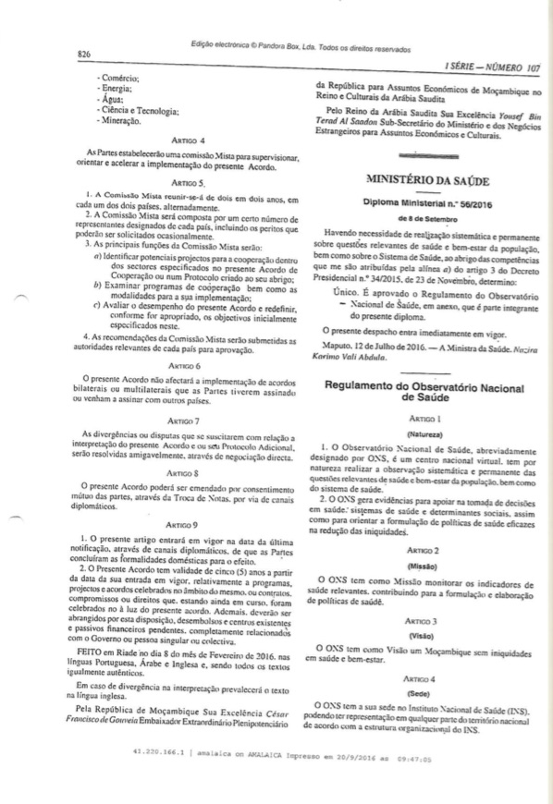
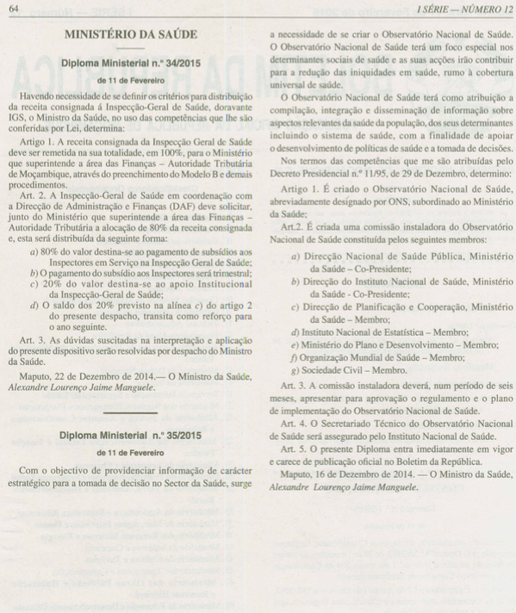
The ONS is a Virtual Yet Legally Established Structure of the State
Internal Regulations of the O.N.S. (2016)
Establishment of O.N.S. (2015)

Slide 6
The Technical Work of the ONS is Performed Through Multi-Institutional Platforms (Working Groups)
Mortality
Maternal and Child Health
Antimicrobial Resistance
Health Systems
Climate and Health
HIV/AIDS
ONS Platforms

Slide 7
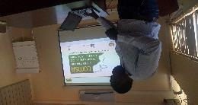
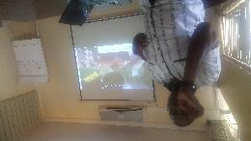
Composition of the ONS Mortality Platform and Main Data Sources
Ministry of Health:
Planification and Cooperation Directorate
Public Health Directorate
Medical Services Directorate
National Institute of Health (INS) (incl. COMSA)
National Institute of Statistics (INE) (incl. COMSA)
Ministry of Justice
Civil Registration and Vital Statistics Directorate
CHAMPS Site Manhiça Health Research Center (CISM)
World Health Organization (WHO)
US Centers for Disease Control and Prevention (CDC)
(Others as interest on the subject grows)
Routine Data
SIS-ROH
CRVS
Surveys/ Research
INCAM
COMSA
CHAMPS
DHIS-2

Slide 8
Some Examples of the ONS Mortality Platform Ongoing and Planned Activities
Standardisation
To create a working group to standardize the different methodologies for collecting and analyzing mortality data
Data triangulation
To triangulate the different sources of mortality data in order to generate information on mortality rates, causes of death and social determinants associated with mortality in Mozambique
Data dissemination
To promote the dissemination and use of information on mortality for policy makers, academic community and the general public
Data to action
Ongoing Activity: Reviewing of report “Comparison of Cause of Death Classification Methods for Verbal Autopsies in Mozambique 2017 INCAM-2 Pilot ”
Pending Activity: Availability of COMSA data for data triangulation
Pending Activity: Synchronization of CHAMPS data on CHAMPS, CISM and ONS websites for data dissemination
To raise awareness among policy makers on the use of information generated and disseminated by the ONS
Pending Activity: Development of policy briefs/discussions according to data becoming available

Slide 9
Some Next Steps for the ONS Mortality Platform
National
Mortality dashboard
Public debates
Provincial/
District
Case based discussion with health facilities
Training of health professionals based on DeCoDe findings
Community
Community tablets/ health fairs for interaction with the community
Policy briefs
Meetings with local stakeholders for data dissemination
Meetings with stakeholders for data dissemination

Slide 10
Obrigado Thank You
Visit:
Instituto Nacional de Saúde (www.ins.gov.mz)
Observatório Nacional de Saúde (www.ons.gov.mz)

